Slide 1
The Acute Abdomen:
What not to miss
Tze Chia
True North Imaging
Annual CME Day
April 9, 2017

Slide 2
RUQ pain

Slide 3
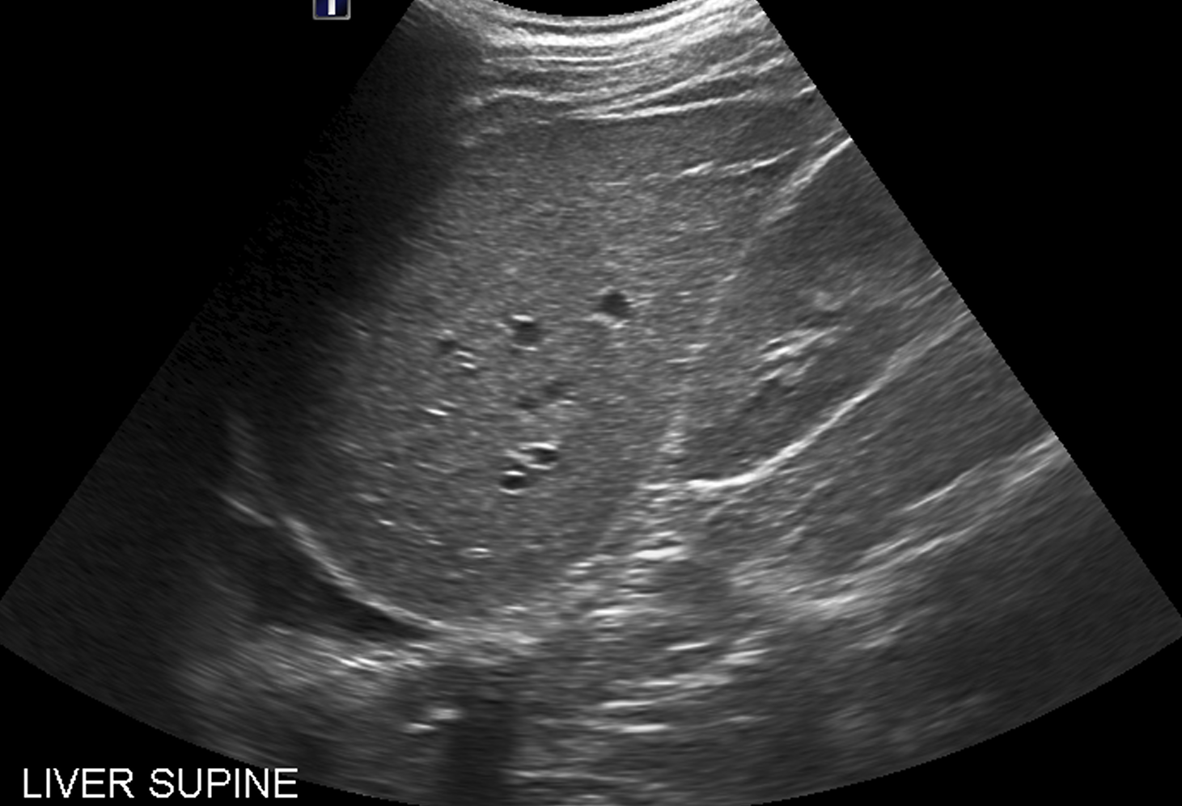

Slide 5
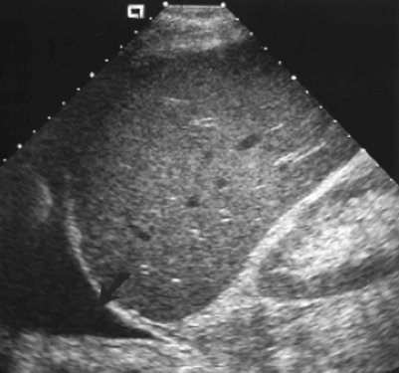
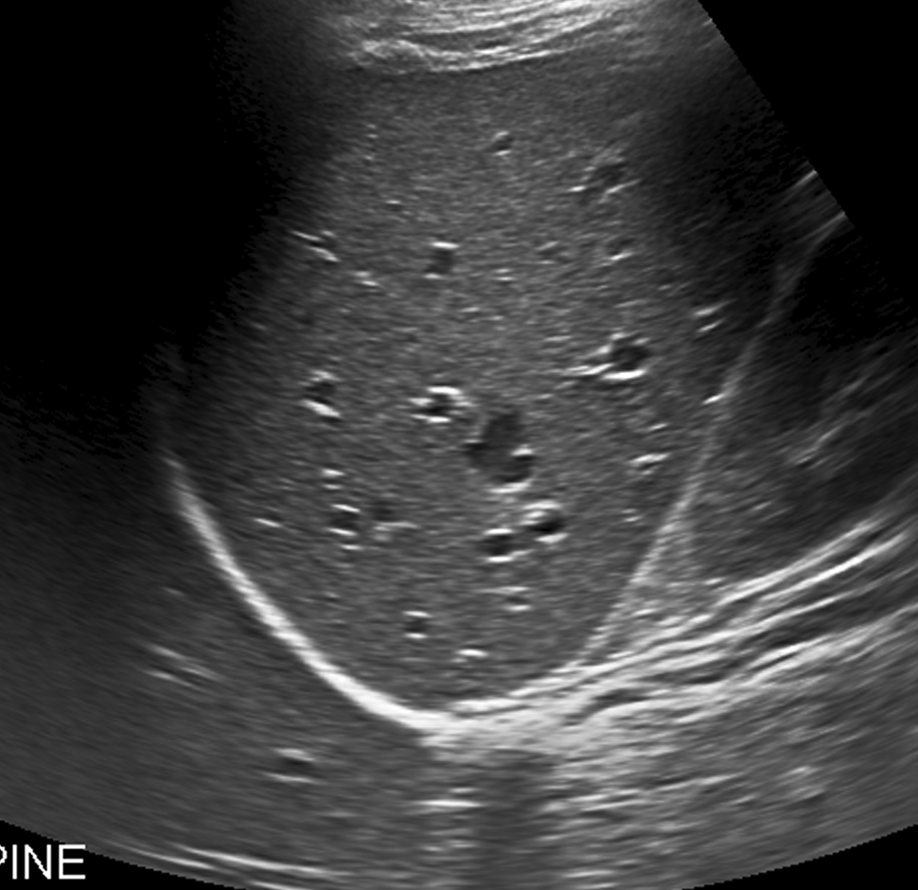
Pleural Effusion
Normal

Slide 6
Pleural effusion
Can present as RUQ pain
Things to do:
  You will only find it if you look for it
  **RUQ pain: Assess gallbladder, CBD, right kidney, pleural effusion**

Slide 7
RUQ pain

Slide 8
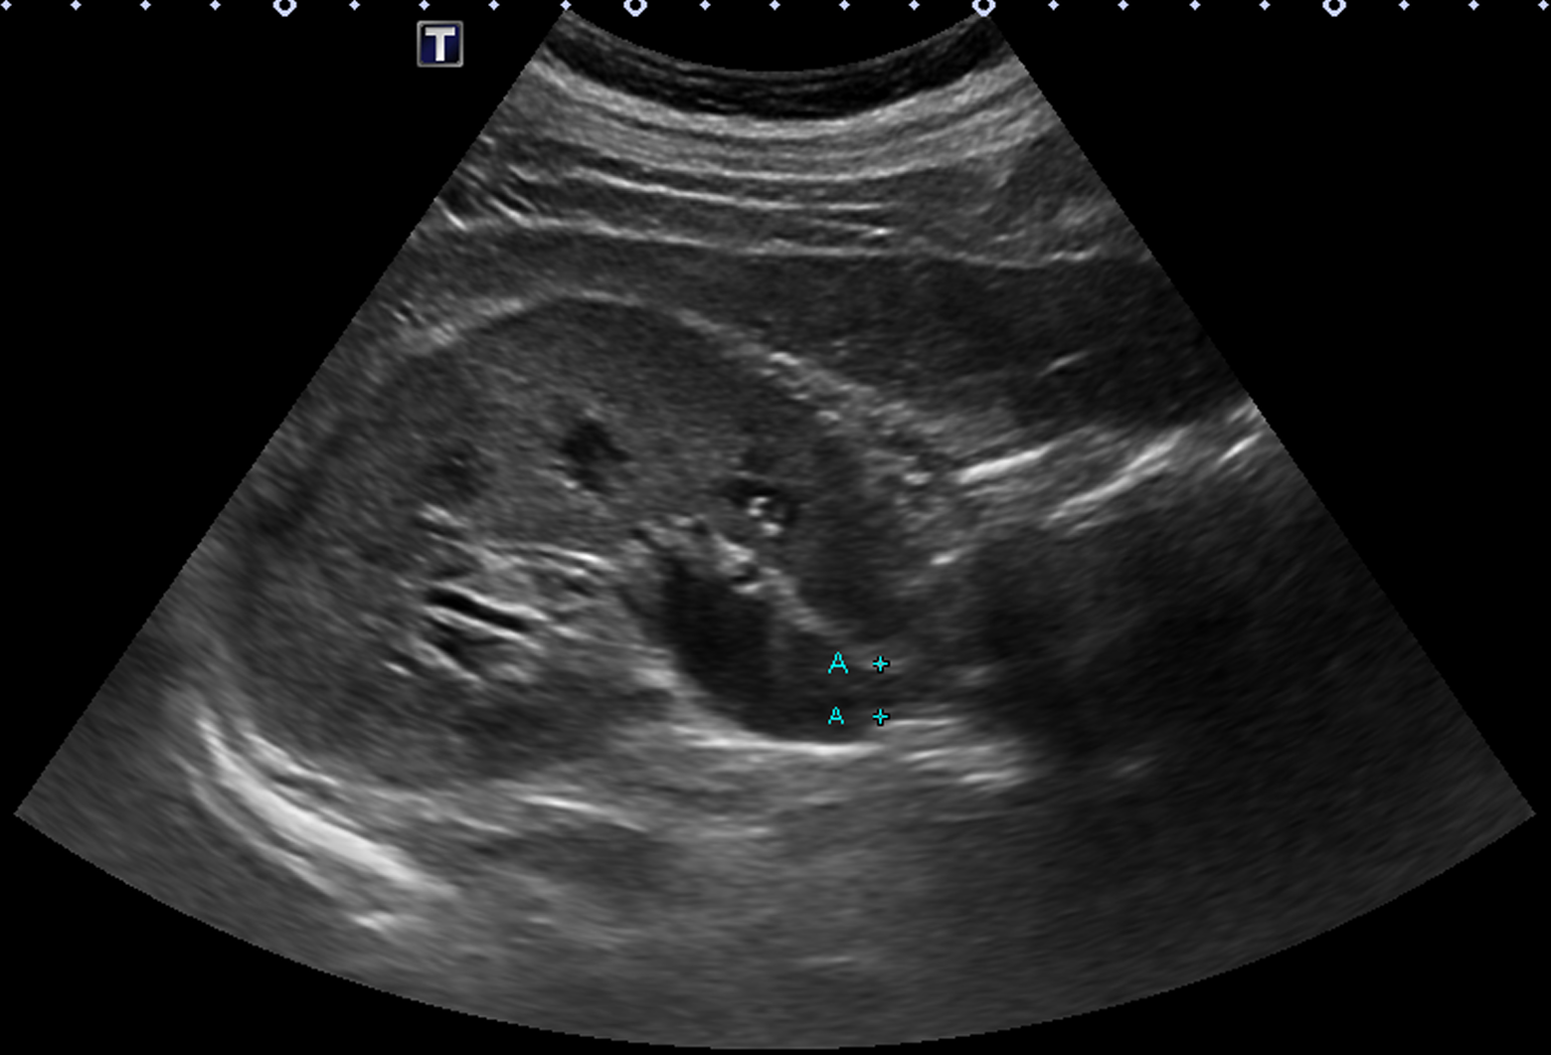

Slide 9
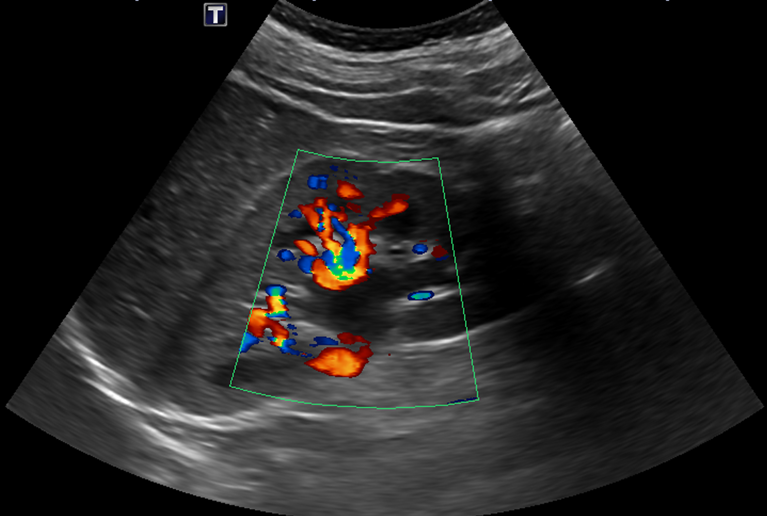

Slide 10
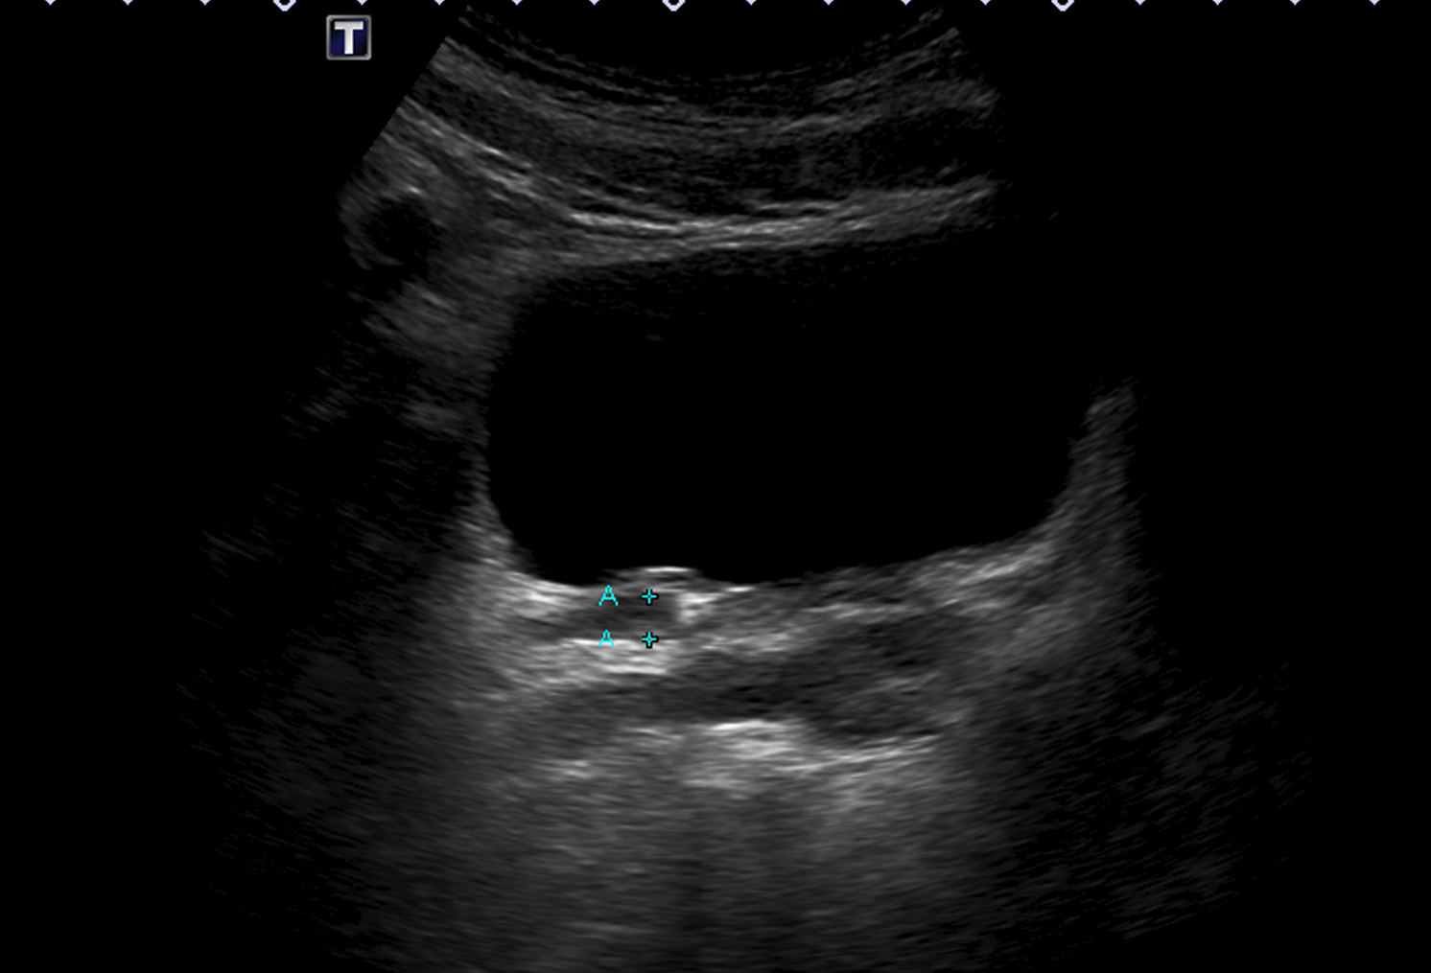
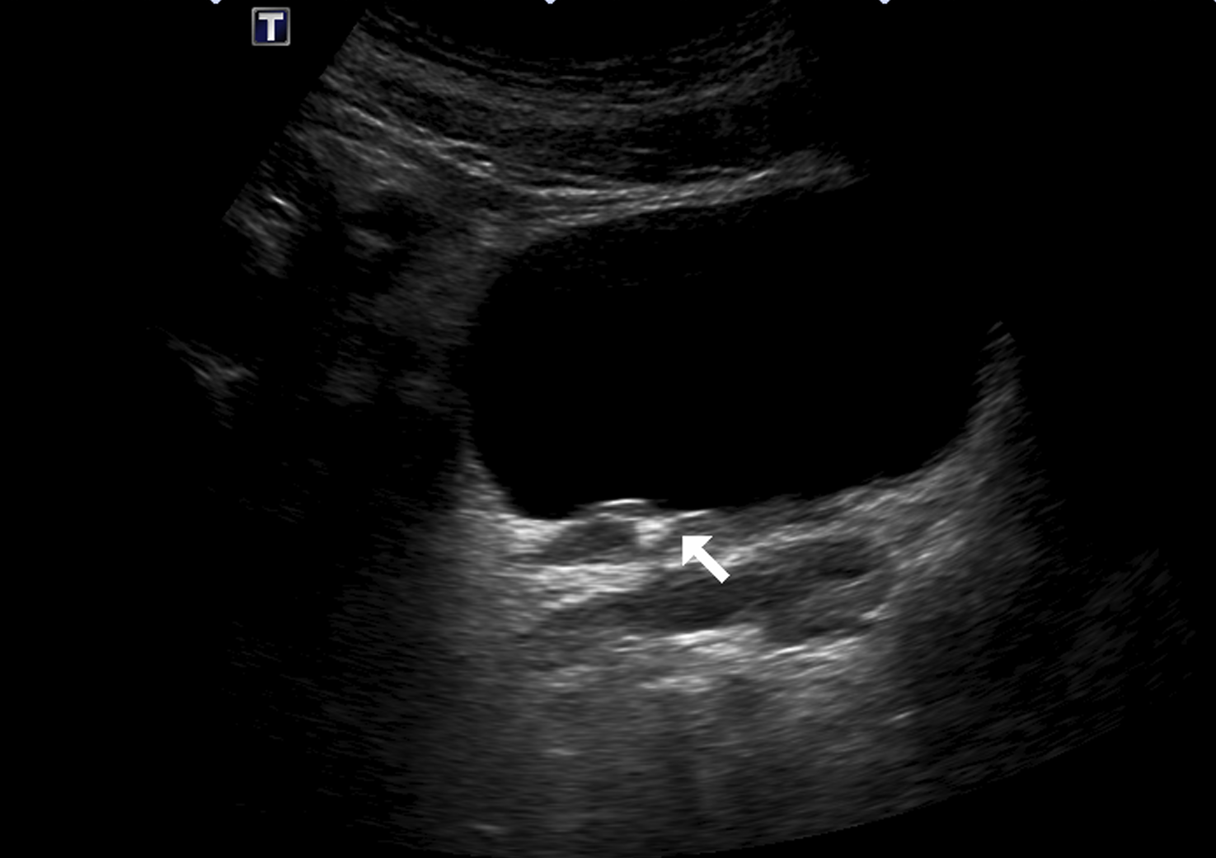
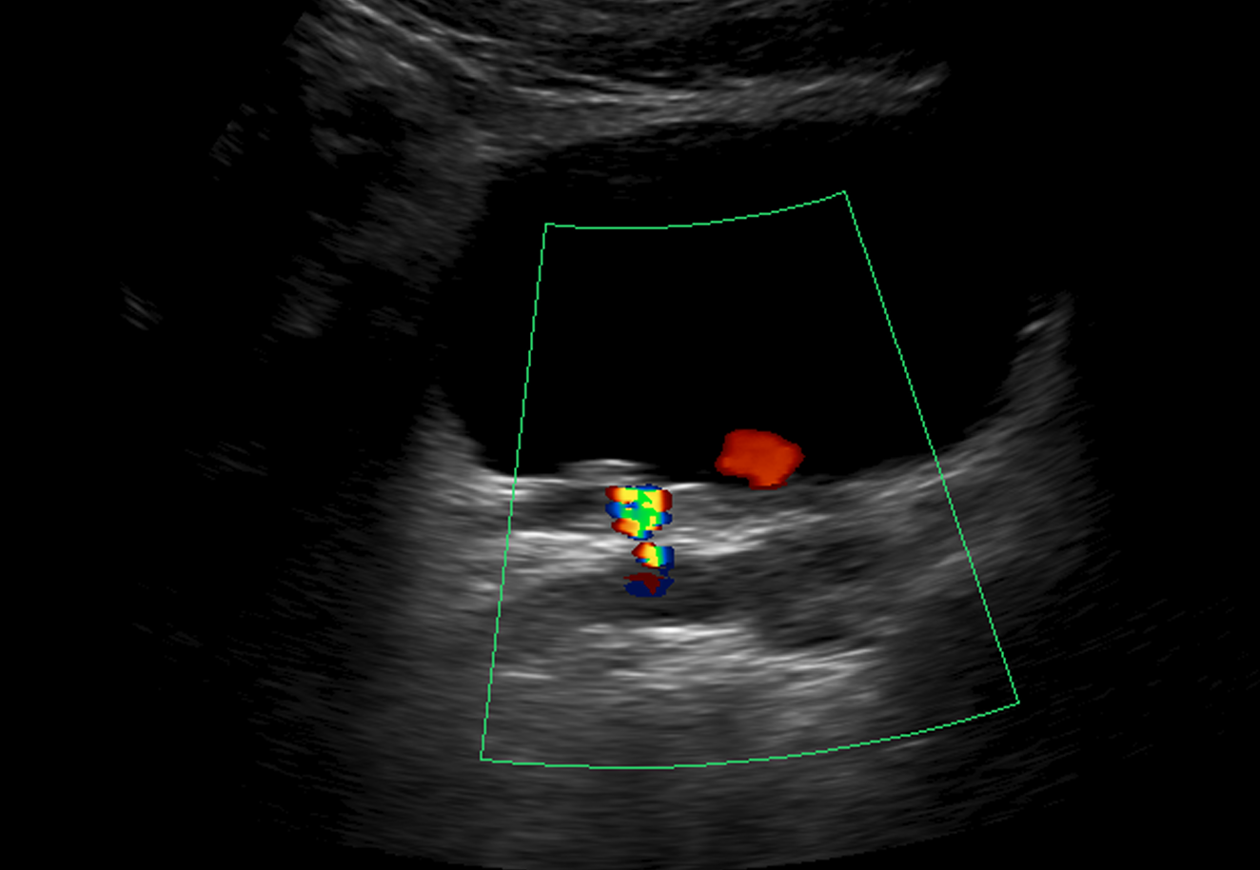

Slide 12
Hydronephrosis
Common causes:
  Reflux
  Stone
  Tumor
  Extrinsic compression (fibroid, pregnancy, etc)
Things to do:
  Post-void imaging***
  Check ureteric jets
  Assess for cause of obstruction along entire collecting system, if possible
  **RUQ pain: Assess gallbladder, CBD, right kidney, pleural effusion**

Slide 13
RUQ pain

Slide 14
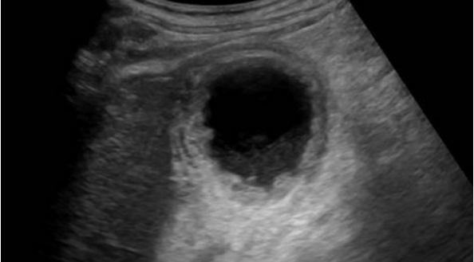
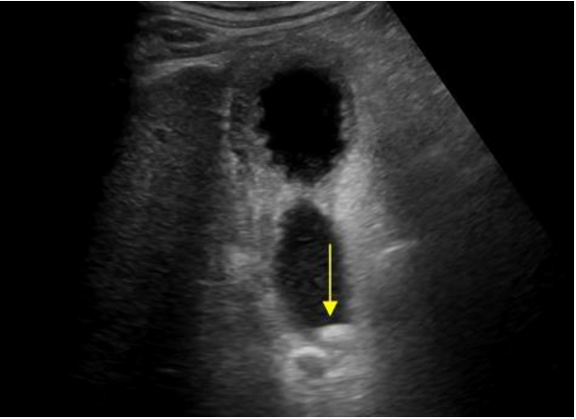
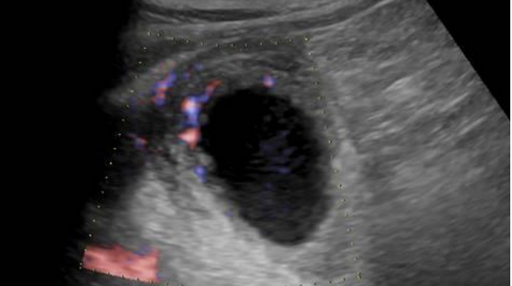

Slide 16
Acute cholecystitis
Findings:
  Cholelithiasis
  Sonographic Murphy’s sign
  Distended gallbladder
  Gallbladder wall thickening
  Pericholecystic fluid
Things to do:
  Must document sonographic Murphy’s sign
  Assess gallbladder neck, cystic duct and CBD
  **RUQ pain: Assess gallbladder, CBD, right kidney, pleural effusion**

Slide 17
RUQ pain

Slide 18
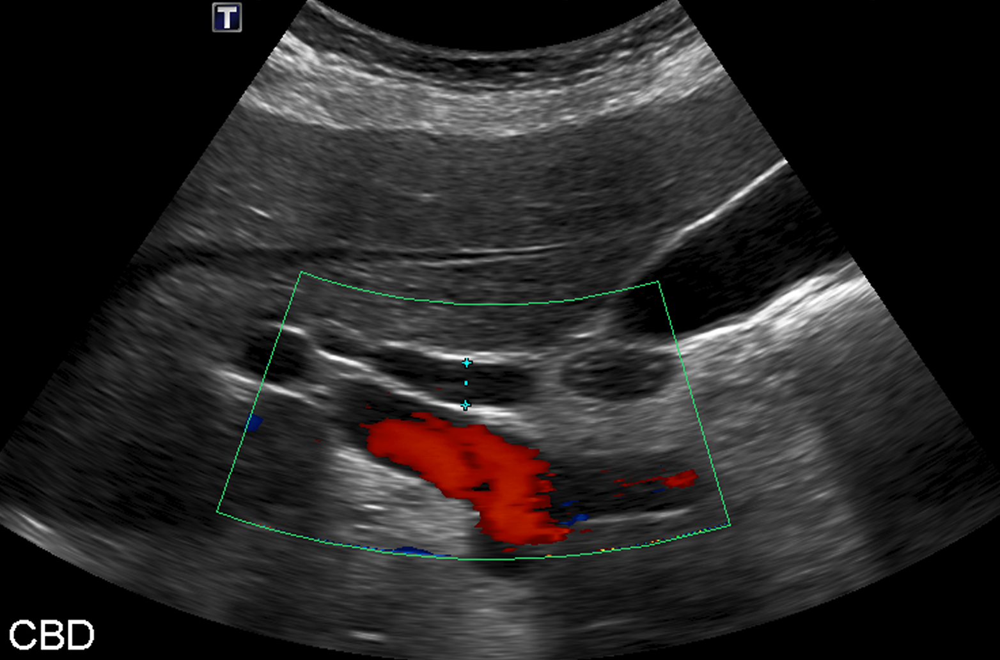

Slide 19
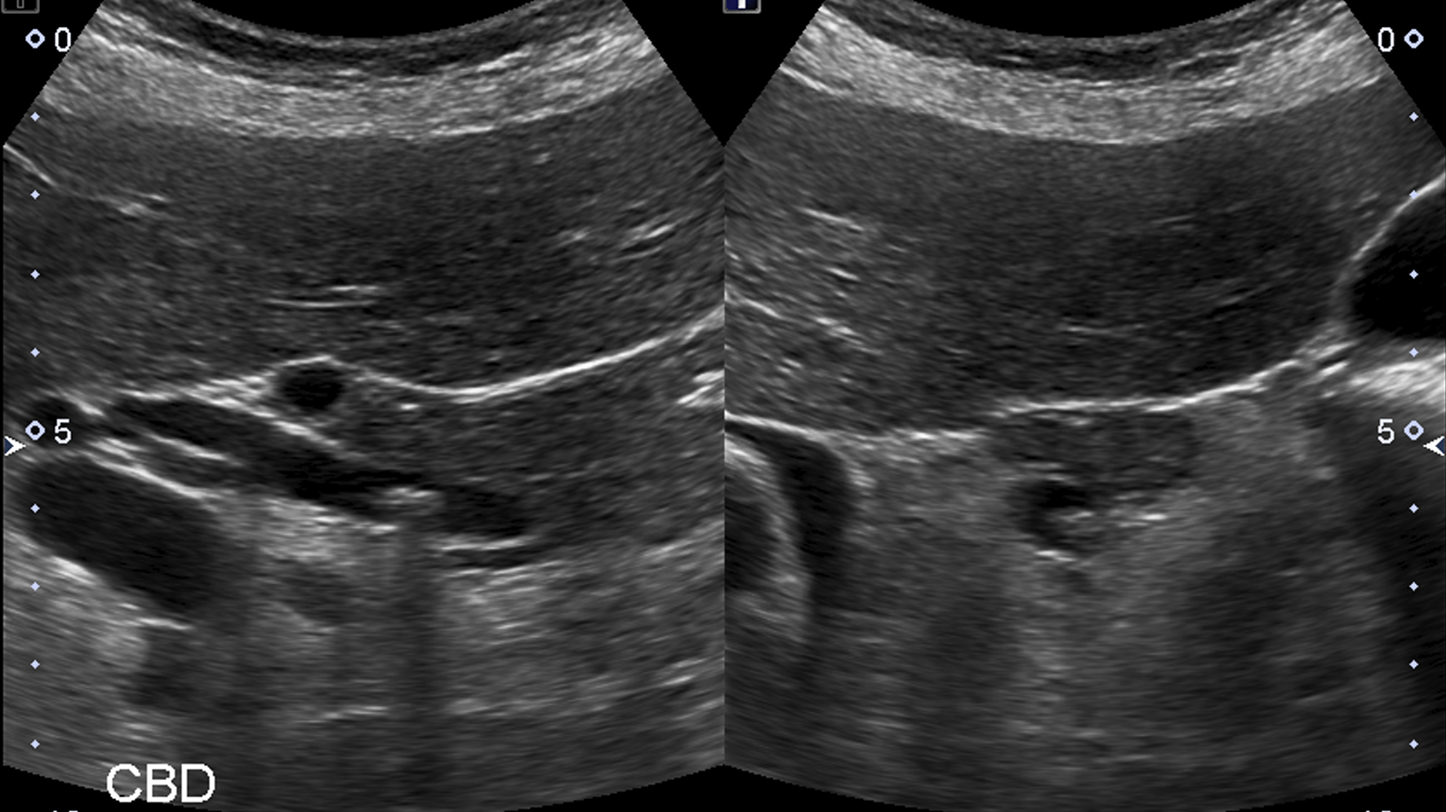

Slide 20
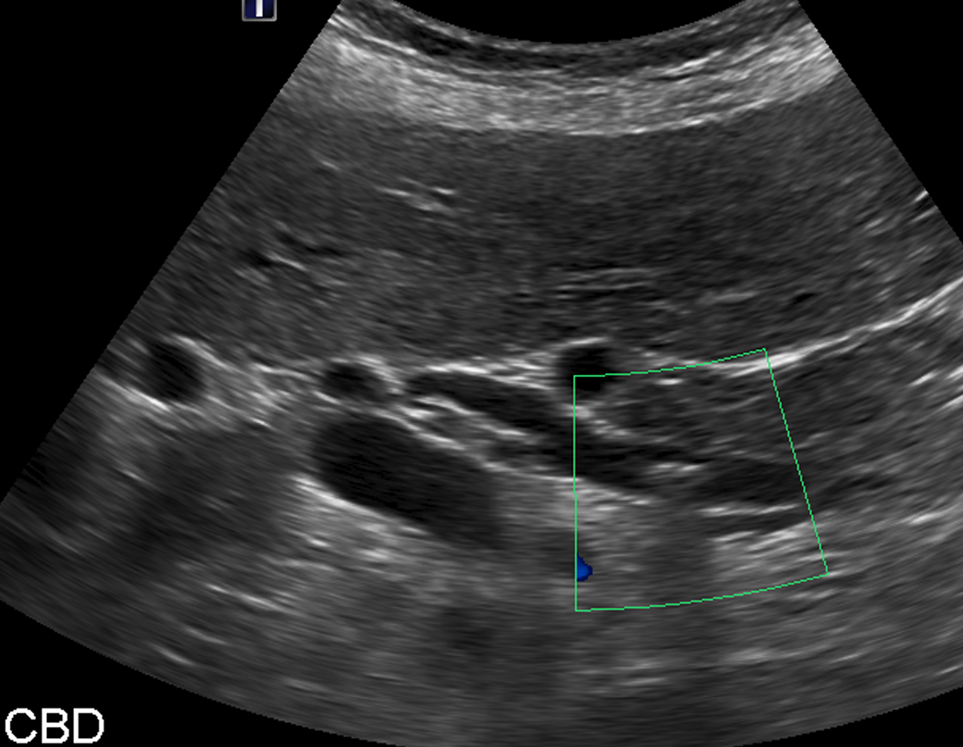

Slide 22
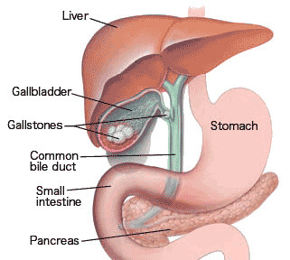
Choledocholithiasis
Stones can form at any point in the biliary tree
Even in the absence of a gallbladder

Slide 23
Choledocholithiasis
Findings:
  +/- dilated CBD
  +/- dilated intrahepatic biliary tree
  Presence of shadowing stone
Things to do:
  Important to visualize the entire CBD
  Assess gallbladder neck and cystic duct as well
  **RUQ pain: Assess gallbladder, CBD, right kidney, pleural effusion**

Slide 24
RLQ pain

Slide 25
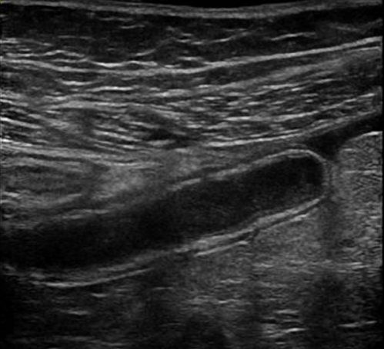
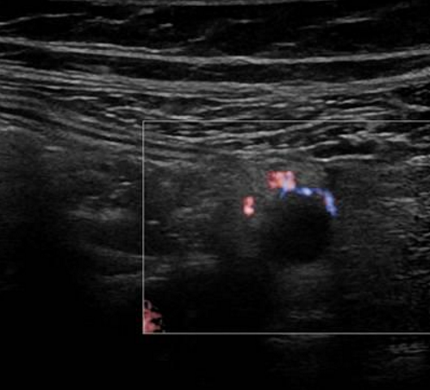

Slide 26
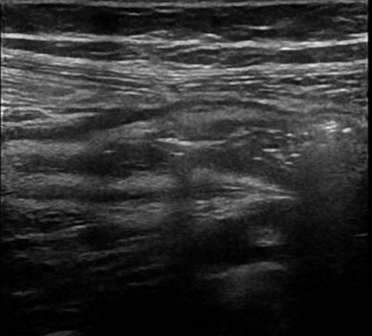
Inflamed cecum

Slide 28
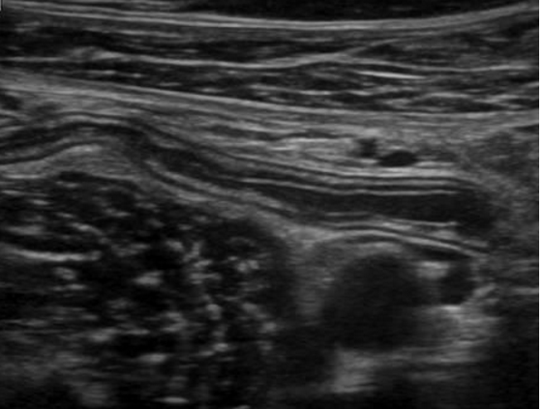
Acute appendicitis
Normal

Slide 29
Acute appendicitis
“Gut Signature”
  Alternating hyperechoic and hypoechoic lines
  Echogenic: Mucosa
  Hypoechoic: Muscularis mucosa
  Echogenic: Submucosa (THICKEST)
  Hypoechoic: Muscularis propria
  Echogenic: Serosa

Slide 30
Acute appendicitis
Identify appendix:
  Blind-ending tubular structure. No peristalsis
  Has “gut signature”
  Always inferior to the terminal ileum
Acute appendicitis:
  Diameter >6mm
  Non-compressible
  May find appendicolith
  Echogenic fat + free fluid
  Inflamed cecum

Slide 31
Acute appendicitis
Things to do:
  Visualize entire length from the cecum to the tip. Appendix can measure up to 20 cm(!!)
  Assess for echogenic fat + free fluid + abscess formation
  Look for complicated fluid!
  **RLQ pain: Assess gallbladder, CBD, right kidney, right ovary, appendix**

Slide 32
RLQ pain

Slide 33
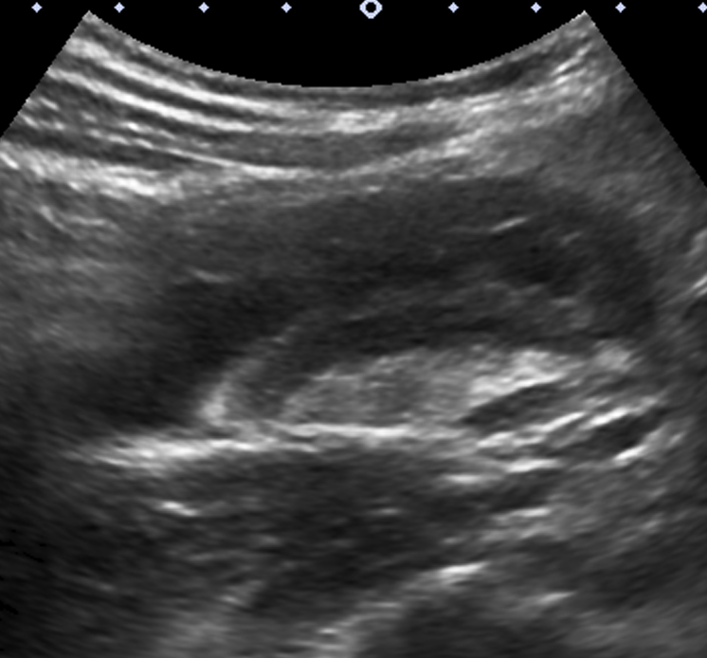
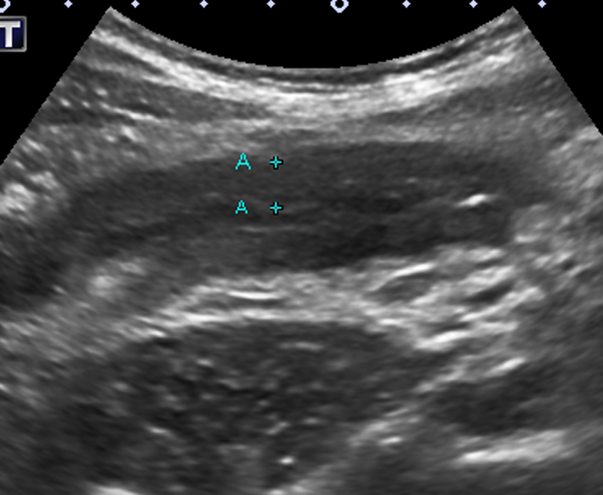
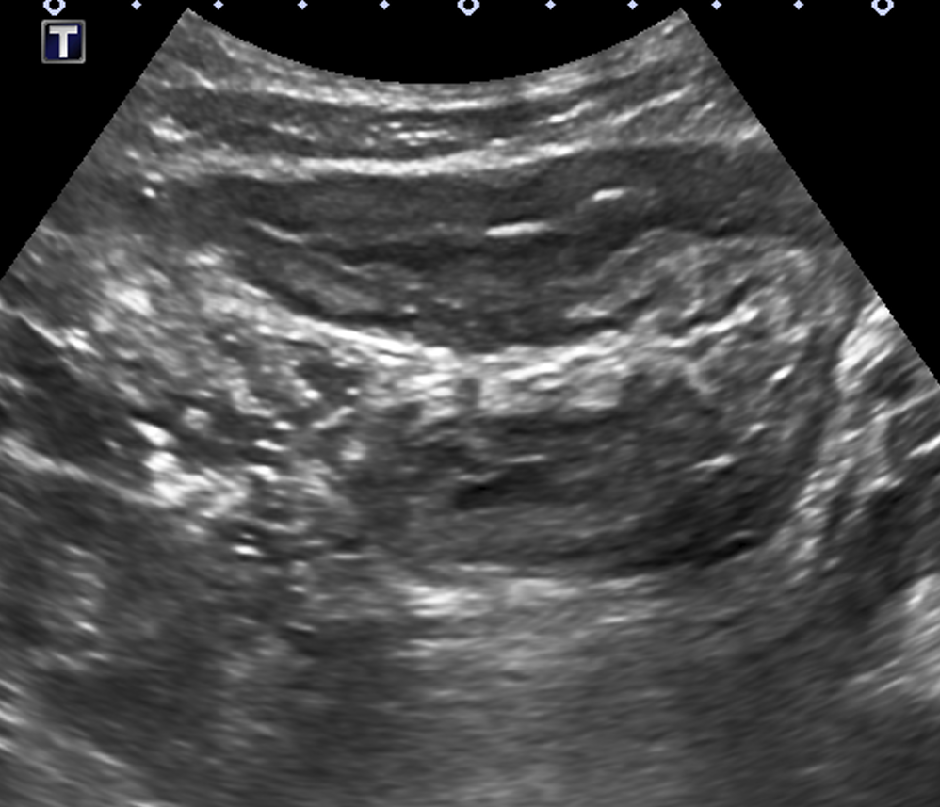
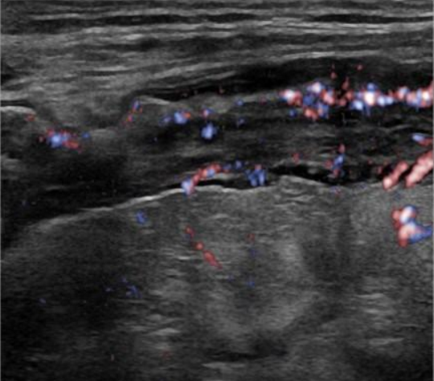

Slide 35
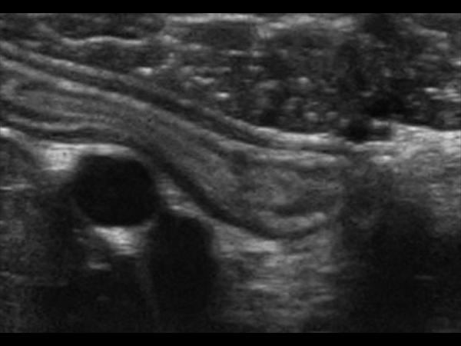
Inflamed bowel (Crohn’s)
Inflamed small bowel
Normal bowel with preserved gut signature

Slide 36
Inflamed bowel
“Gut Signature”
  Alternating hyperechoic and hypoechoic lines
  Echogenic: Mucosa
  Hypoechoic: Muscularis mucosa
  Echogenic: Submucosa (THICKEST)
  Hypoechoic: Muscularis propria
  Echogenic: Serosa
Normal bowel with preserved gut signature

Slide 37
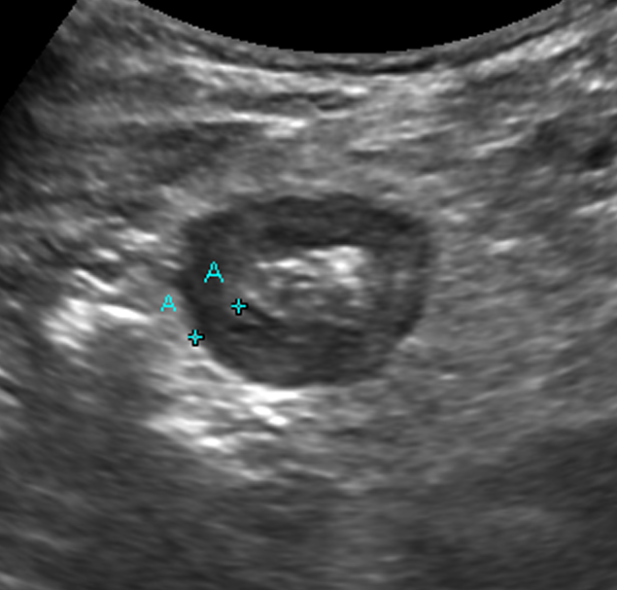
Inflamed bowel
Normal?
NO

Slide 38
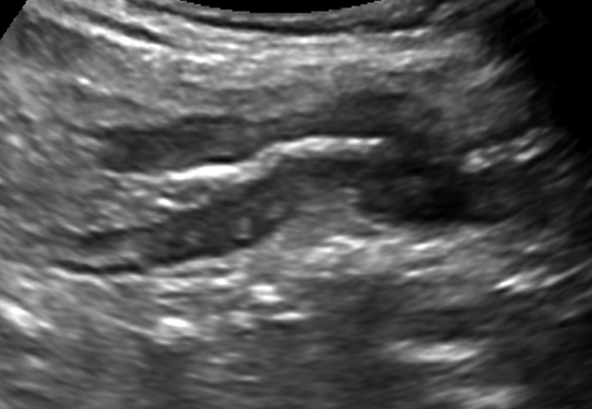
Inflamed bowel
Normal?
NO

Slide 39
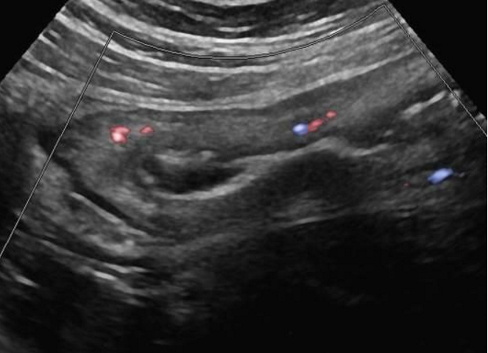
Inflamed bowel
Normal?
NO

Slide 40
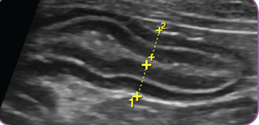
Inflamed bowel
Normal?
NO. Thickening of muscularis layers. Crohn’s.

Slide 41
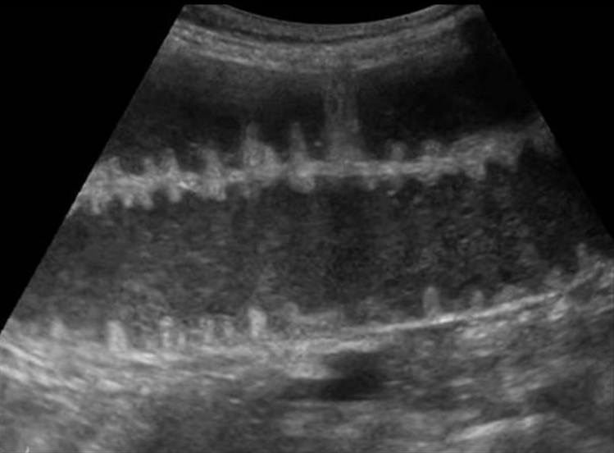
Inflamed bowel
Normal?
NO. Bowel obstruction

Slide 42
Inflamed bowel
Findings:
  Loss of gut signature
  Bowel wall thickness > 3mm
  Non-compressible
  Free fluid
  Echogenic fat
Things to do:
  Assess bowel wall thickness
  Assess for echogenic fat + free fluid + abscess formation
  **RLQ pain: Assess gallbladder, CBD, right kidney, right ovary, appendix**

Slide 43
RLQ pain

Slide 44
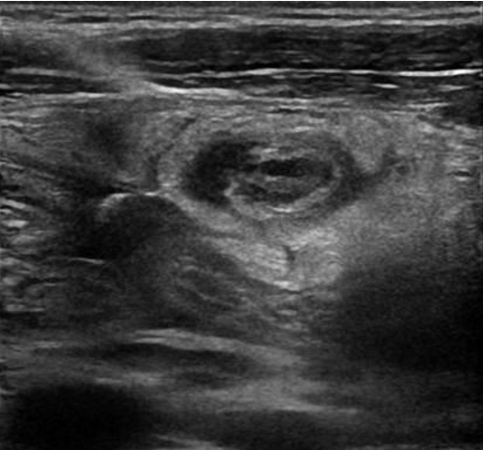
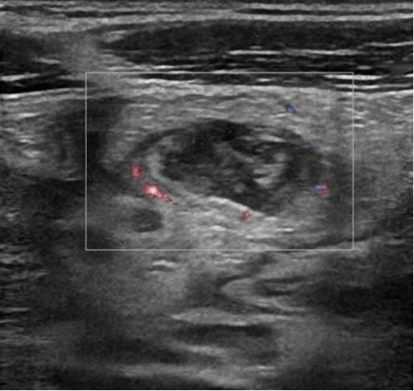

Slide 46
Cecal diverticulitis
Findings:
  Outpouching of colon wall
  Thickening of the bowel wall
  Surrounding echogenic fat and free fluid
Things to do:
  Assess for echogenic fat + free fluid + abscess formation
  **RLQ pain: Assess gallbladder, CBD, right kidney, right ovary, appendix**

Slide 47
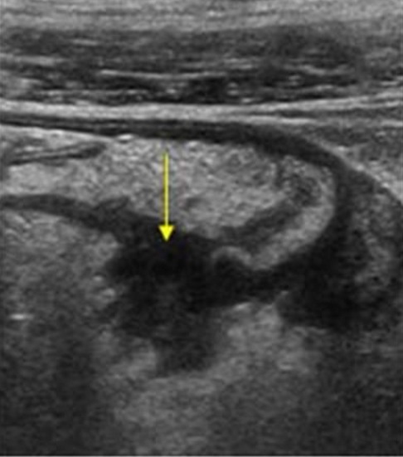
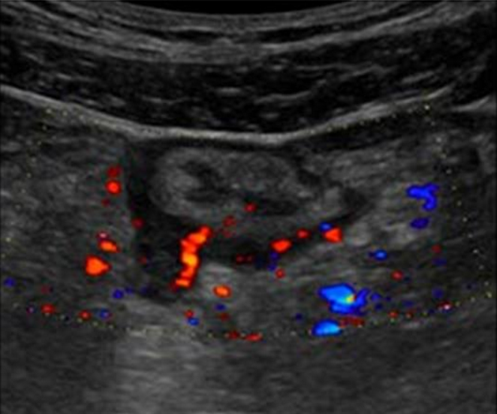
Sigmoid diverticulitis

Slide 48
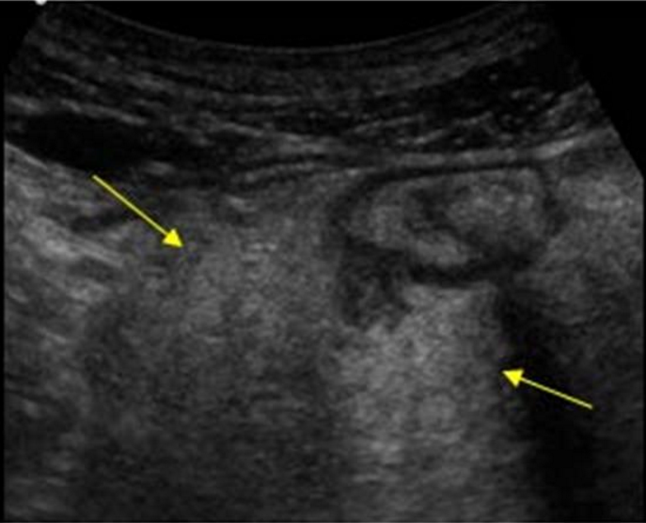
Sigmoid diverticulitis
Echogenic fat

Slide 49
RLQ pain

Slide 50
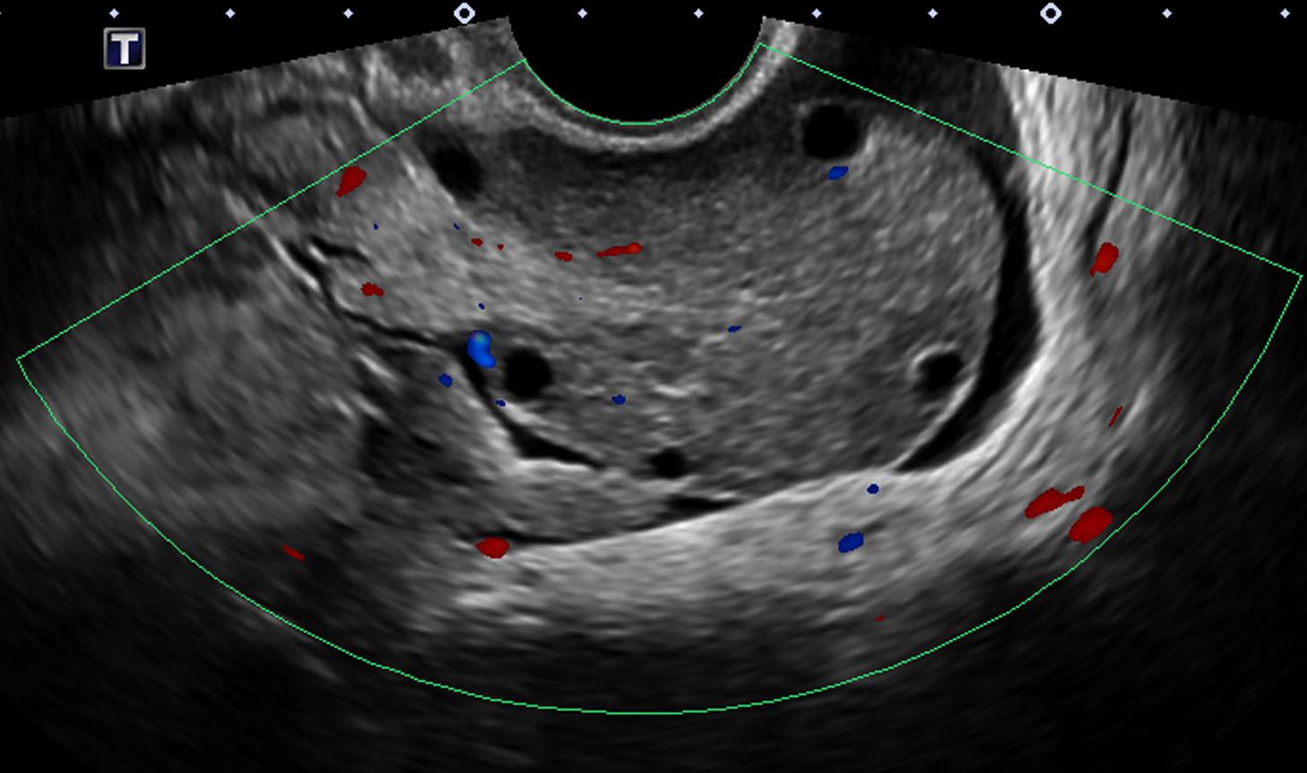
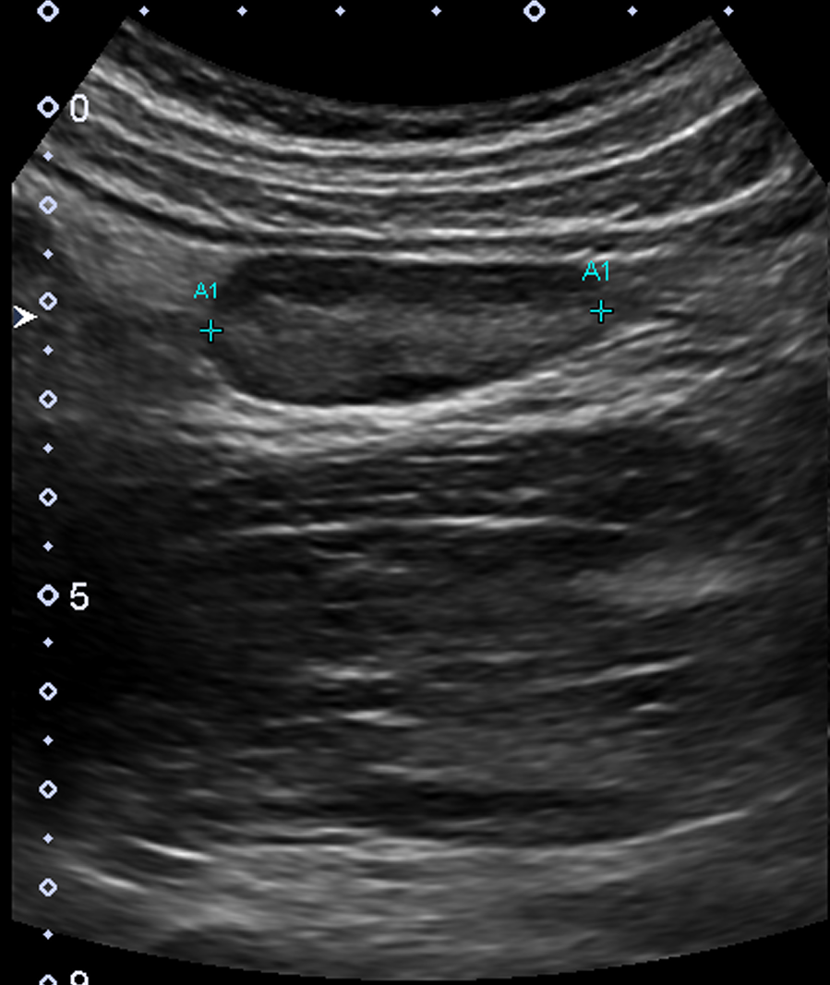
Right Ovary (vol = 34cc)
Left Ovary (vol = 11cc)

Slide 51
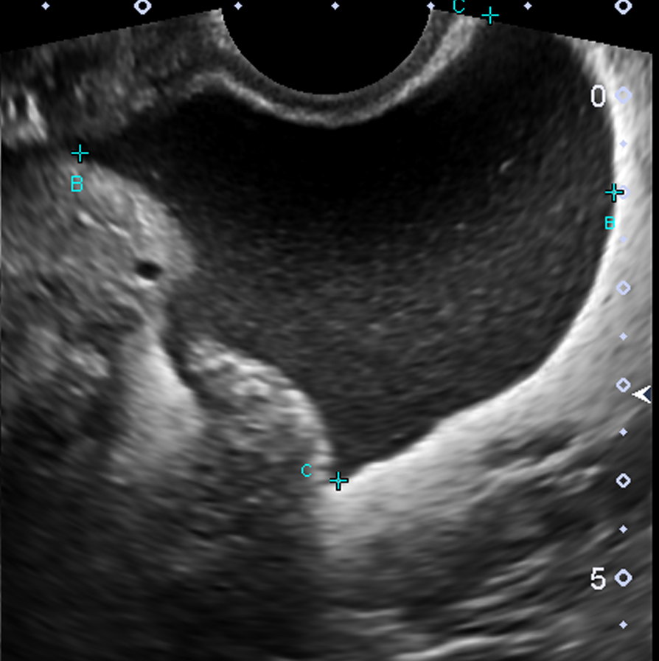
Complicated fluid

Slide 52
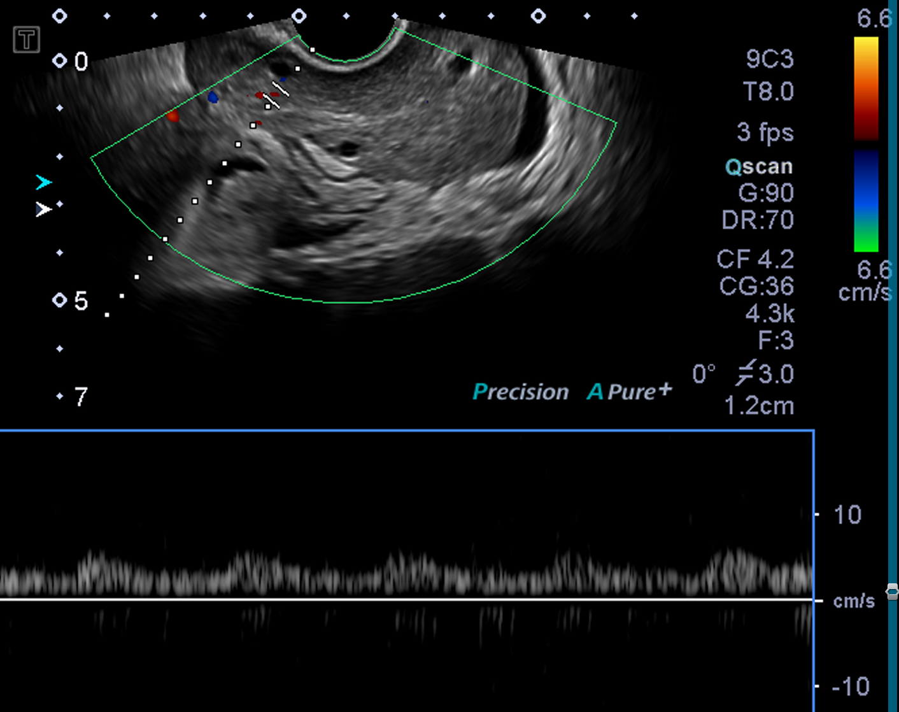

Slide 54
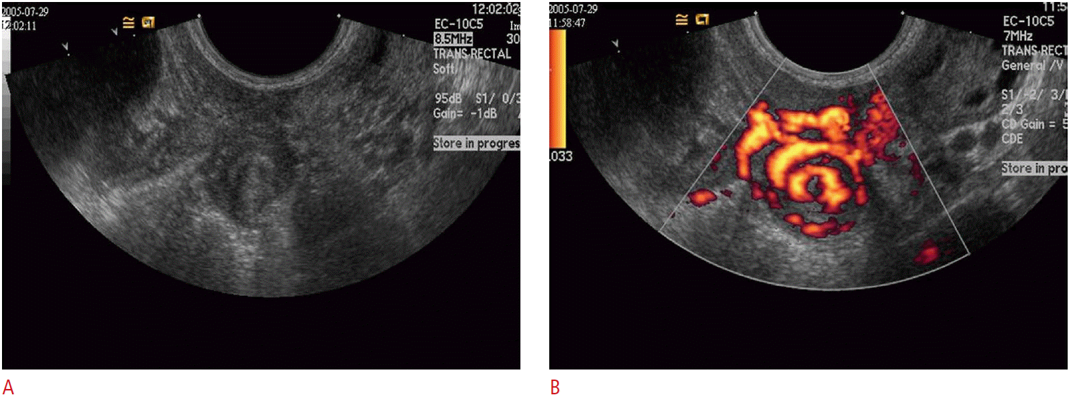
Ovarian torsion
Findings:
  Enlarged, edematous ovary
  Echogenic stroma
  Peripherally displaced follicles
  Ovary displaced to the midline
  Free pelvic fluid
  Whirlpool sign
  Abnormal vascularity
    Absent venous flow
    Absent arterial flow
    Absent arterial diastolic flow
Whirlpool sign – twisting of pedicle

Slide 55
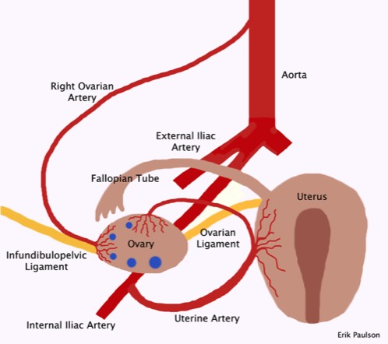
Ovarian torsion
Dual blood supply from:
  Ovarian artery
  Uterine artery
NORMAL VASCULARITY DOES NOT EXCLUDE TORSION!!

Slide 56
Ovarian torsion
Things to do:
  Check for ovarian edema
  Check for ovarian lesion (higher risk for torsion)
  Assess vascularity (colour + duplex)
  Look for complicated fluid!
  **RLQ pain: Assess gallbladder, CBD, right kidney, right ovary, appendix**

Slide 57
Generalized abdominal pain

Slide 58
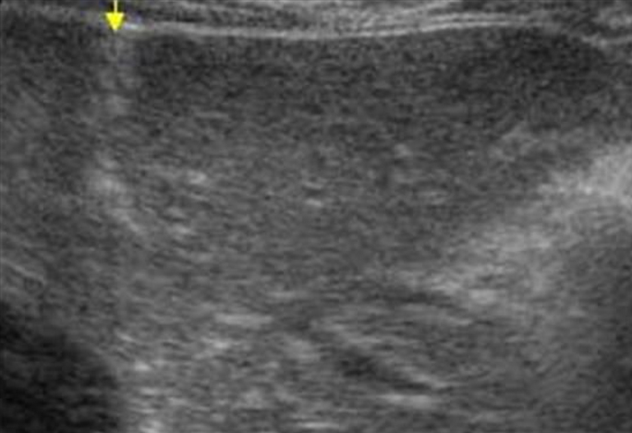
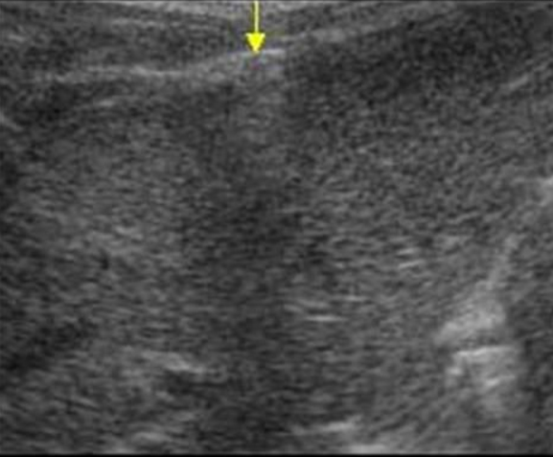

Slide 59
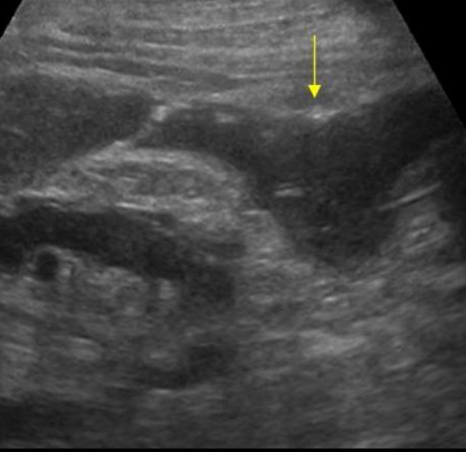
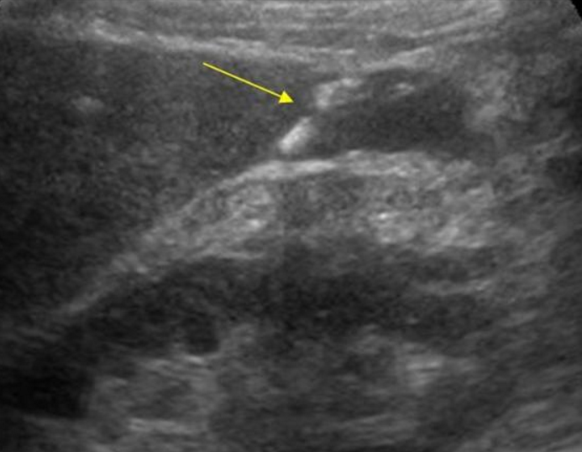

Slide 60
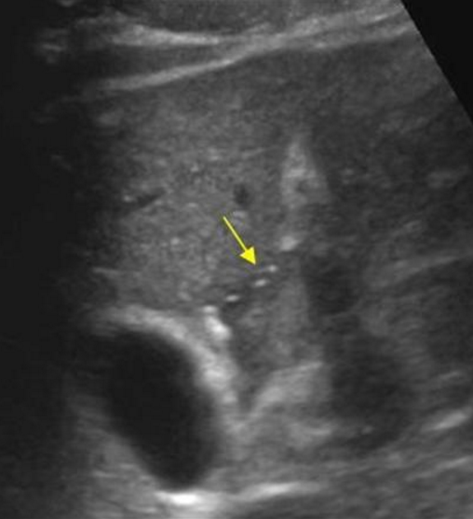
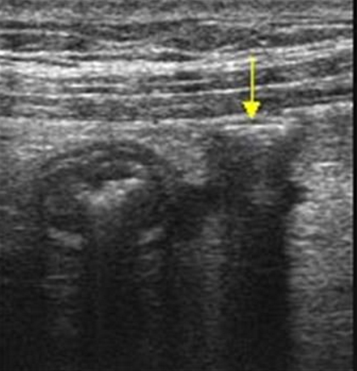

Slide 61
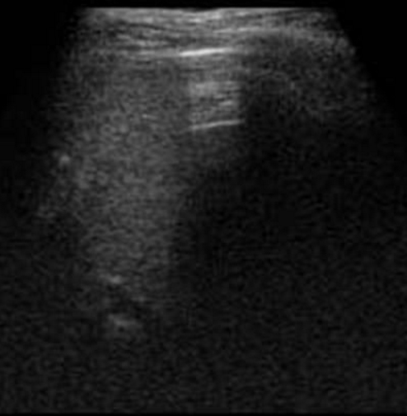
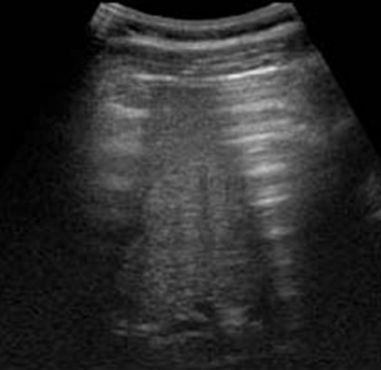

Slide 63
Pneumoperitoneum
Findings:
  Peritoneal stripe sign
    Enhancement of the peritoneal stripe

Slide 64
Pneumoperitoneum
Findings:
  Peritoneal stripe sign
  Reverberation artifact /
  ring down artifact

Slide 65
Pneumoperitoneum
Findings:
  Peritoneal stripe sign
  Reverberation artifact /
  ring down artifact
  Dirty shadowing

Slide 66
Pneumoperitoneum
Findings:
  Peritoneal stripe sign
  Reverberation artifact /
  ring down artifact
  Dirty shadowing
Things to do:
  Stay alert for air outside bowel!

Slide 67
Left Neck Lump

Slide 68
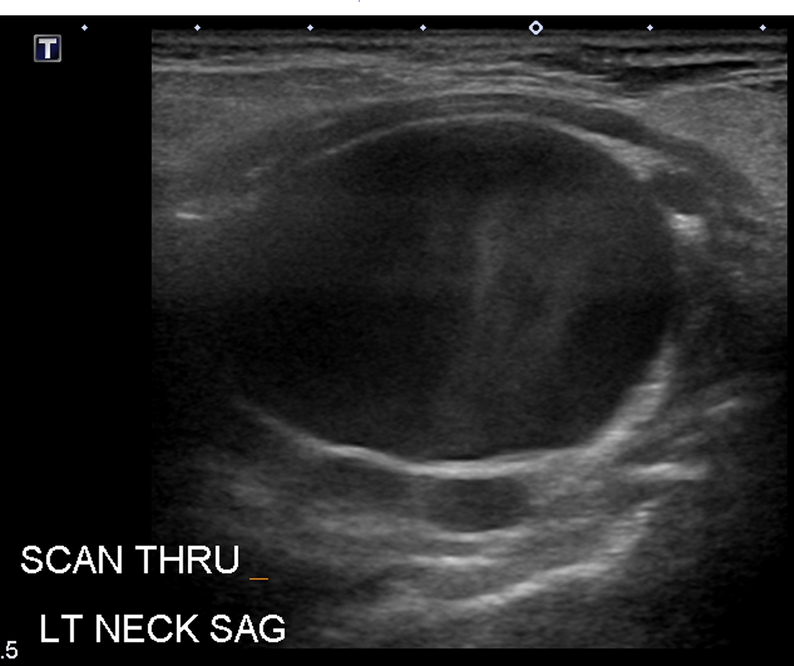

Slide 69
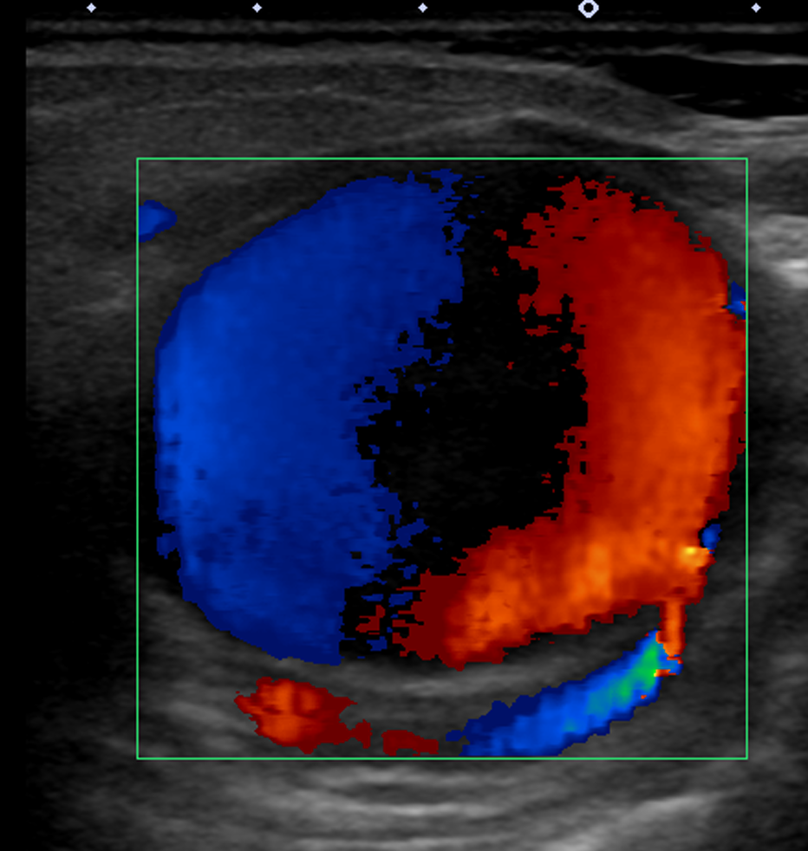

Yin-Yang Sign

Slide 70


Slide 71


Slide 73


Pseudoaneurysm
Not contained by intima or media
Higher risk of rupture than true aneurysms
Treatment required

Slide 74
Pseudoaneurysm
Findings:
  Yin-Yang sign
Common causes:
  Trauma
  Iatrogenic (arterial catheterization, biopsy, surgery)j
  Spontaneous
Things to do:
  Yin-Yang sign
  Duplex doppler
  Aneurysm neck, if possible

Slide 75
Key points
RUQ pain:
  **Assess gallbladder, CBD, right kidney, pleural effusion**
RLQ pain:
  **Assess gallbladder, CBD, right kidney, right ovary, appendix**
Some findings will only be seen if you look for them:
  Pleural effusion
  Pneumoperitoneum
  Complicated free fluid

Slide 76
Key points
Acute cholecystitis
  Document sonographic Murphy’s sign
  Visualized GB neck, cystic duct and CBD
Acute appendicitis
  Image entire length from cecum to blind-ending tip
Hydronephrosis
  Post-void imaging + ureteric jets
Ovarian torsion
  Ovaries have dual blood supply
  Preserved vascularity does not exclude torsion

Slide 77
Key points
Complicated fluid
  Look for it
  Determine cause
Bowel ultrasound is challenging
  Look for gut signature
  Echogenic fat
  Free fluid/abscess

